Slide 1



Date & Time
Sai Vardhan T

Slide 2
DATE
In SQL, DATE is a data type that stores the date. It does not store time information.
The format of the date is, ‘YYYY-MM-DD’. For instance, ‘2022-01-01’.
SQL provides several functions to handle and manipulate dates.
Let’s see some examples of how to use the DATE data type in SQL

Slide 3
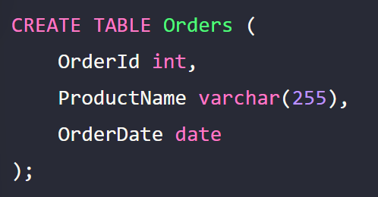
Create a table with DATE data type
In this example, the OrderDate column uses the DATE data type to store the date of the order.

Slide 4
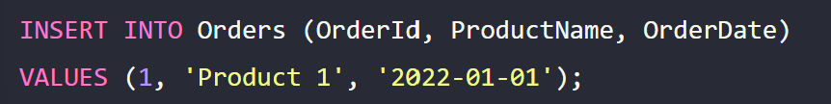
Insert a date value into a table
This command inserts a new row into the Orders table with a date.

Slide 5
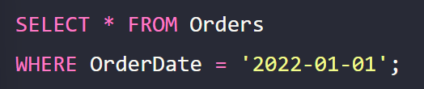
Retrieve data with a specific date
This command retrieves all orders made on January 1, 2022.

Slide 6
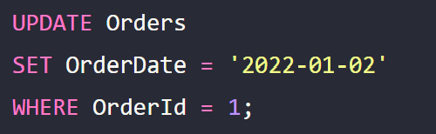
Update a date value in a table
This command updates the date from January 1, 2022 to January 2, 2022, for the order with the order ID 1.

Slide 7

Range and Fetching Data
Range
The time range in SQL is “00:00:00” to “23:59:59”
Fetching Data
To fetch data you can use the SELECT statement
It will return the time values from table

Slide 8
Date Functions
In SQL, the DateTime data type is used to work with dates and times.
SQL Server comes with numerous functions for processing dates and times.
Some of these include:
CURRENT_DATE()
DATEADD()
DATEDIFF()

Slide 9

CURRENT_DATE()
Returns the current date.

Slide 10
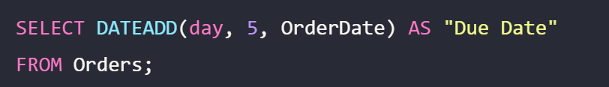
DATEADD()
Add or subtract a specified time interval from a date.

Slide 11
DATEDIFF()
Get the difference between two dates.

Slide 12
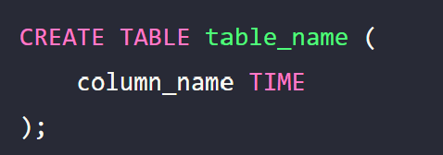
TIME
In SQL, TIME data type is used to store time values in the database.
It allows you to store hours, minutes, and seconds.
The format of a TIME is ‘HH:MI:SS’.
SYNTAX:

Slide 13
INSERTING DATA
This command inserts a new row into the Orders table with a TIME.
SYNTAX:

Slide 14
TIME FUNCTIONS
SQL provides several functions to work with the TIME data type. Some of them include:
CURTIME()
ADDTIME()
TIMEDIFF()
CONVERSION

Slide 15

CURTIME() | ADDTIME()
Returns the current Time
Add time values

Slide 16

TIMEDIFF() | CONVERSION
Subtract time values
Conversion of time data type is also possible in SQL

Slide 17
TIMESTAMP
SQL TIMESTAMP is a data type that allows you to store both date and time.
It is typically used to track updates and changes made to a record, providing a chronological time of happenings.
The format is as follows
‘YYYY-MM-DD HH:MI:SS

Slide 18
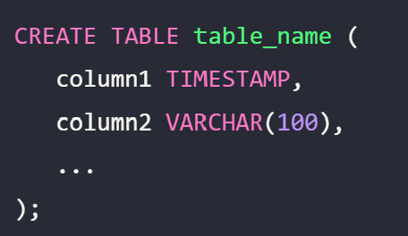
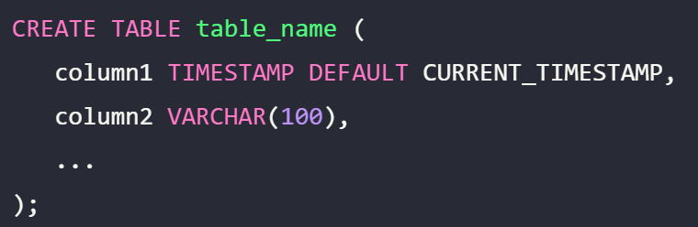
CREATING TABLE

Slide 19
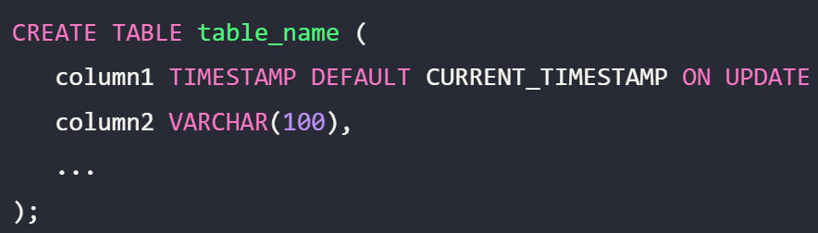

UPDATE CURRENT_TIMESTAMP
In MySQL, ON UPDATE CURRENT_TIMESTAMP can be used to automatically update the TIMESTAMP field to the current date and time whenever there is any change in other fields of the row.

